Slide 1

Visual of Nobel Prize Winners
- Sean Mohomane

Slide 2
How Many Records?
We have 911 records from which to analyse data.
Not all Records have entries e.g. ‘sex’

Slide 3
Who wins?
From a total of 911 possibly shared prizes, majority of them are males with 836 of which have won a prize.
The contrast is massive compared to Females who only have 49.
Dominating countries: USA(259) , UK(85), Germany(61), France(51)
The gap is huge, where USA has 259 and coming second is UK with 85 winneres

Slide 4
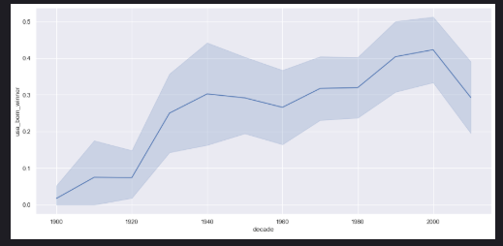
USA Dominance

Slide 5
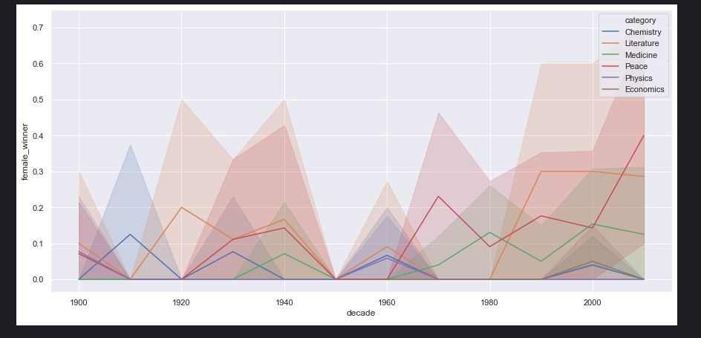
Female Winners by Category

Slide 6
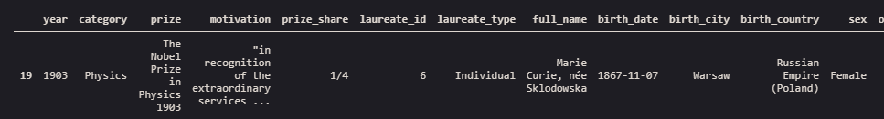
First Female Winner

Slide 7
Repeat Laureates
It’s not by luck that winners obtain a prize more than once.
These few are:
John Bardeen
Marie Curie, née Sklodowska
Comité international de la Croix Rouge (Intern...
Linus Carl Pauling
Office of the United Nations High Commissioner...
Frederick Sanger

Slide 8
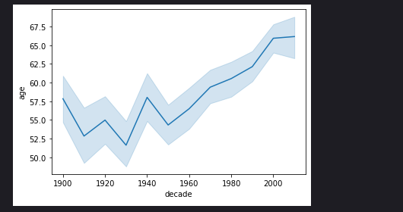
Age Difference

Slide 9
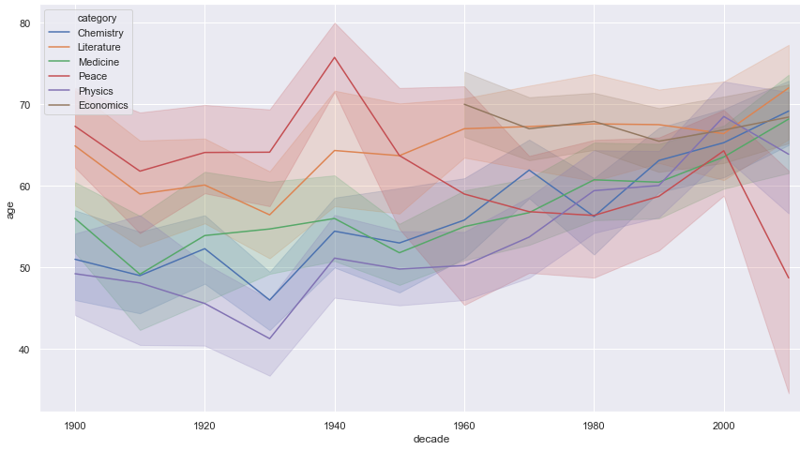
Age by Category

Slide 10
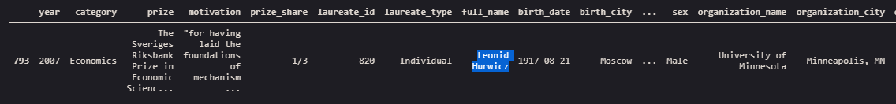
Oldest and Youngest Prize Winners

